Slide 1

Saudi STOCK MARKET EXCHANGE
Tadawul
By
Hanan Alshehri

Slide 2


Tadawul is the Saudi Exchange is a fully owned subsidiary by Saudi Tadawul Group. As Saudi Arabia’s dedicated stock exchange and the largest stock exchange in the Middle East. The goal of this project is to better understand which factors are most important in Saudi Stock Exchange over 20 years, and to find how various industries represented by stock market indices have reacted to the COVID-19 shock.

Slide 3

Data Structure 600,571 Rows and 14 Columns
DATASET FROM KAGGLE
https://www.kaggle.com/salwaalzahrani/saudi-stock-exchange-tadawul
- The dataset start from 2000 to 2020.
- Import some libraries such as: Pandas, Numpy, Matplotlib, Seaborn
Using Jupyter program

Slide 4
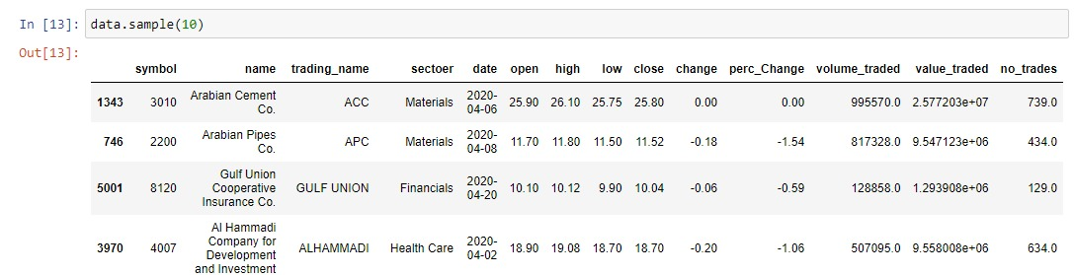
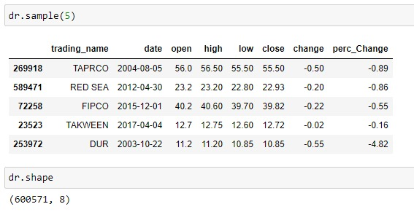
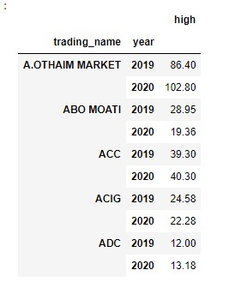
DATAT CLEANING: 1. import two file of data. 2. Merge them to be one date. 3. drop some columns. 4. add column name ‘year’

Slide 5
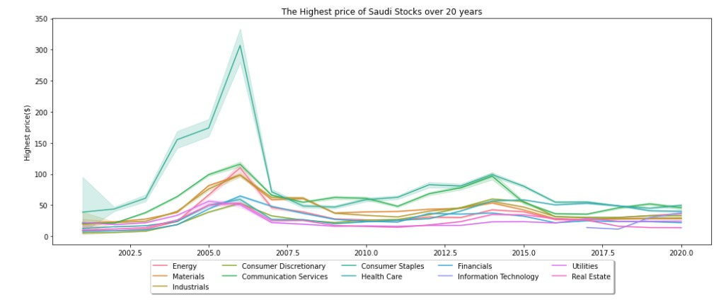
DATA ANALYSIS THE FIRST QUSTION IS ABOUT: What was the change in price of the stock over 20 years?

Slide 6
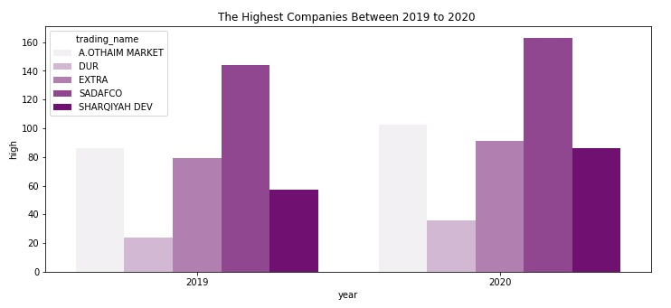
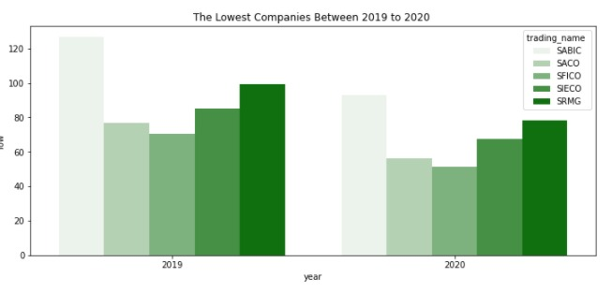
DATAT ANALYSIS THE SECOND QUSTION ABOUT: Checking the effects of COVID-19 on the Saudi stock prices (HIGH,LOW)

Slide 7
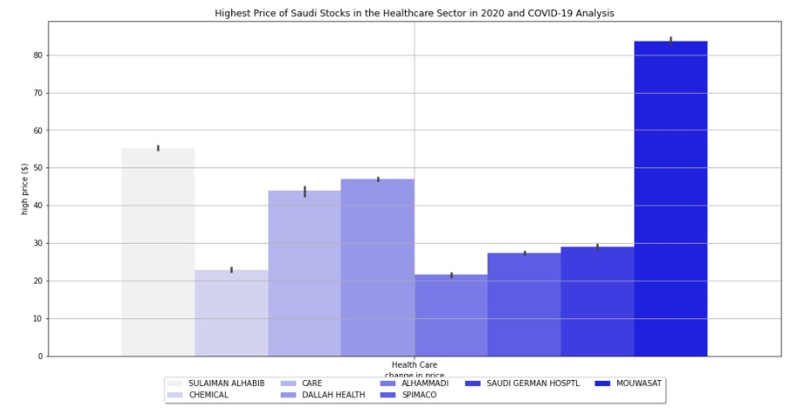
DATA ANALYSIS PART2 FROM THE QUSTION IS ABOUT: Checking the effects of COVID-19 on the Saudi healthcare stock prices

Slide 8
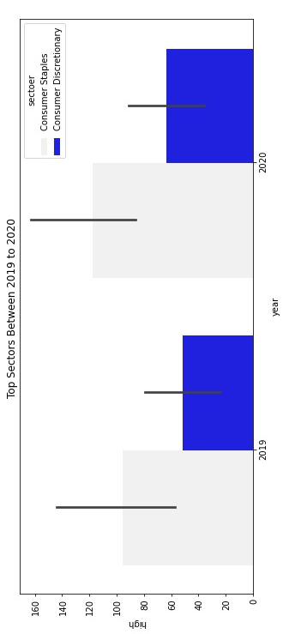
DATAT ANALYSIS THE SECOND QUSTION ABOUT: Checking the effects of COVID-19 on the Saudi stock prices between the top sectors from 2019-2020

Slide 9

Conclusion
1. In the future we will use more libraries such as Keras .
2. Using deep learning (LSTM) to predict stock prices in the coming years.

